Slide 1
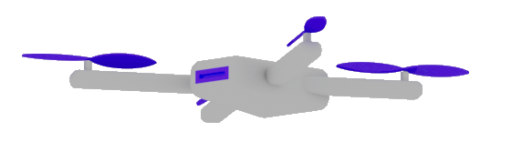
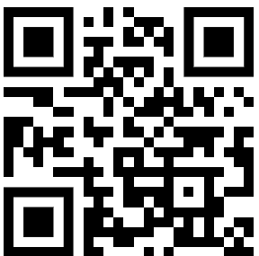
CODING
AI-AGENTS
Dr. Damir Dobric
Lead Software Architect daenet GmbH / ACP Digital
Microsoft Regional Director,
Most Valuable Professional: Azure + IoT

Slide 2

Building Cloud-based Enterprise Applications that leverage GenAI
Dr. Damir Dobric
Lead Software Architect daenet GmbH / ACP Digital
Microsoft Regional Director,
Most Valuable Professional: AI

Slide 3

Software V2
The new Generation of Software
“After tomorrow”
“Tomorrow”
Quantum Computing
Software
Today
AI & Large Language Model Integration
Syntax Driven Languages

Slide 4
DEMO
Software v2
Light Control
PowerShell

Slide 5
What is an Assistent? By Open AI
An OpenAI Assistant is a purpose-built AI that utilizes OpenAI's models and tools to perform specific tasks and respond to user queries.
It can be customized with instructions, leverage tools like code interpreters, and access files, and functions,
all while maintaining persistent threads of conversation.
It's a way to build sophisticated AI-powered applications with copilot-like

Slide 6
What is an AGENT? By Semantic Kernel Team
An AI agent is a software entity designed to perform tasks autonomously or semi-autonomously by receiving input, processing information, and taking actions to achieve specific goals.
Agents are designed to work collaboratively, enabling complex workflows by interacting with each other.

Slide 7
What is an AGENT? By Azure Foundry Team
An AI Agent is a "smart" microservice that can be used to
answer questions (RAG), perform actions (Tools/PlugiIns), or
completely automate workflows.
It achieves this by combining the power of generative AI models with tools that allow it to access and interact with real-world data sources.

Slide 8

Open AI Assistent vs. Azure Agent?
Both services enable you to build agents using the same API and SDKs.
Azure offers additional enterprise requirements as Azure AI Agent Service.
Flexible model selection Many Azure OpenAI models, or others such as Llama 3, Mistral and Cohere.
Extensive data integrations Grounding with secure enterprise knowledge from various data sources, such as Microsoft Bing, Azure AI Search, and other (your) APIs.
Enterprise grade security Ensure data privacy and compliance.

Slide 9
What is a Copilot?
A Copilot is an AI application that solves tasks, offers insights and boost productivity. A Copilot is an interface that might involve one or more agents to orchestrate tasks.

Slide 10
Completions Chat Streaming TextToSpeech Look into the image Image Generation Image Edit Embeddings RunRetrievalAugmentedGenerationAsync();
DEMO OpenAI SDK

Slide 11
Where are models physically located?
Supported models in Azure AI Agent Service

Slide 12
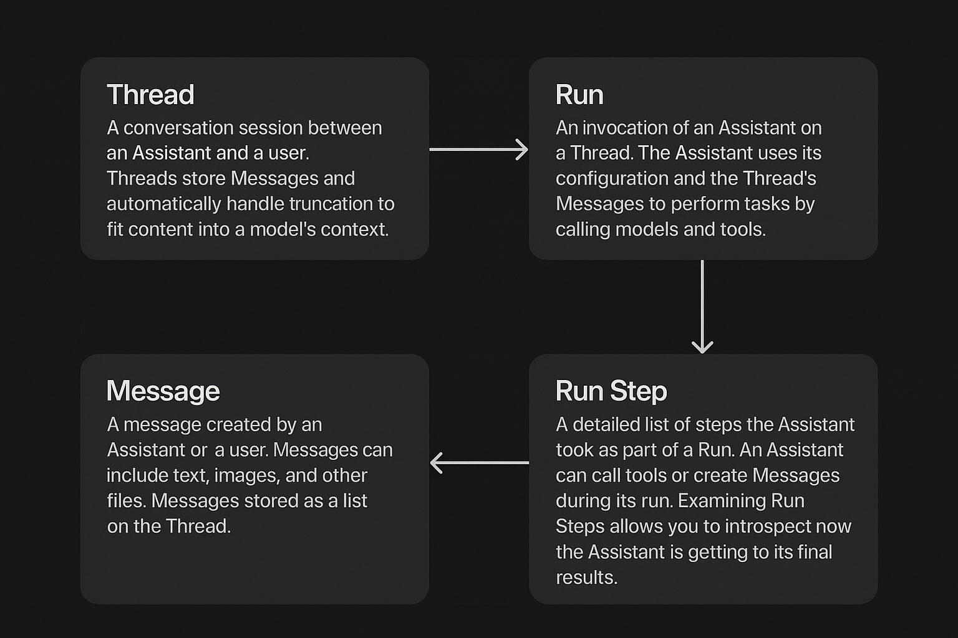
Agent Entities

Slide 13



Agent Threads and Runs
Thread 1
Thread 2
s
s
u
u
a
Run 1
a
Run 1
u
Run 2
a
t

Slide 14
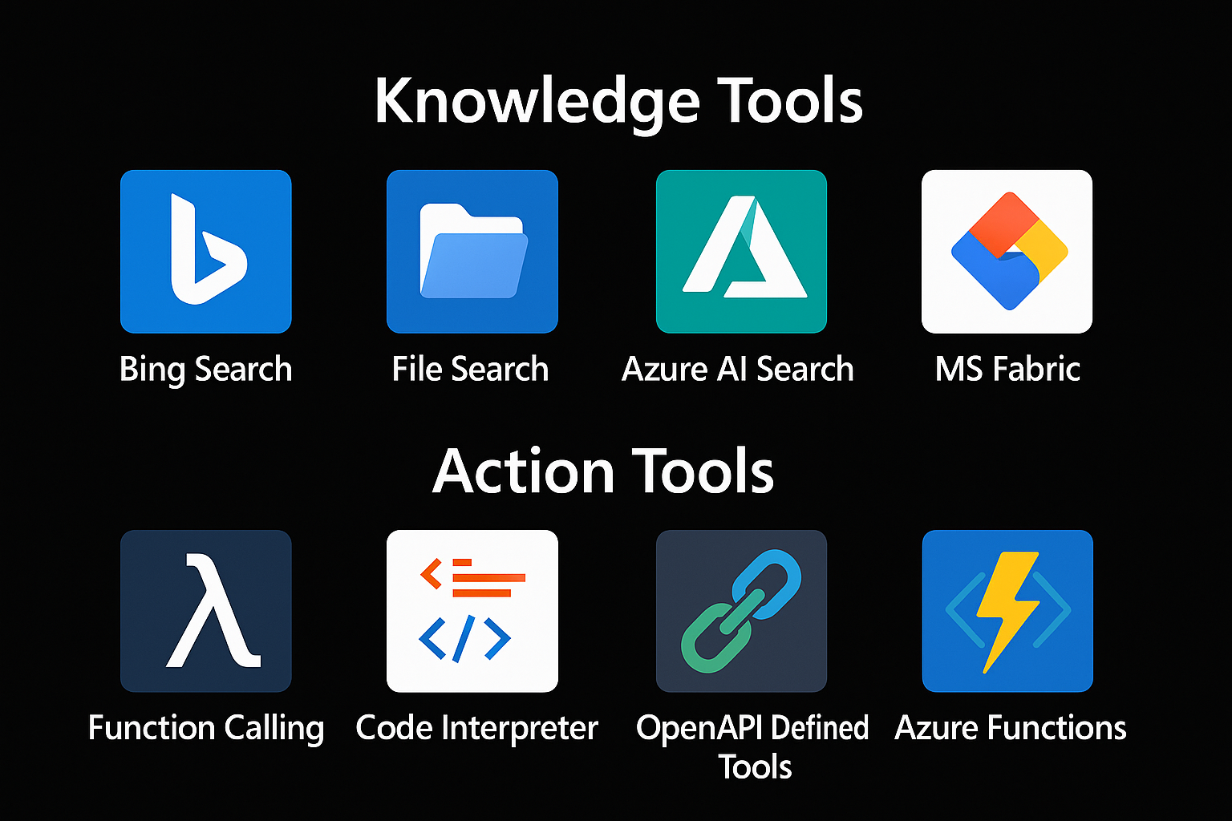
Tools
Knowledge Tools
Bing Search
File Search
Azure AI Search
Ms Fabric API (Licensed Data)
Action Tools
Function Calling
Code Interpreter
Open API Defined Tools
Azure Functions

Slide 15
Function Calling
{
"type": "function",
"function": {
"name": "get_weather",
"description": "Retrieves current weather for the given location.",
"strict": true,
"parameters": {
"type": "object",
"properties": {
"location": {
"type": "string",
"description": "City and country e.g. Bogotá, Colombia"
},
"units": {
"type": ["string", "null"],
"enum": ["celsius", "fahrenheit"],
"description": "Units the temperature will be returned in."
}
},
"required": ["location", "units"],
"additionalProperties": false
}
}
}

Slide 16



Chat Model Interaction
User: How are you?
(1)
AI
Prompt
(2)
Assistent: I‘m fine, ho wcan I help you

Slide 17
Function Calling
User: Switch on the light to green.
LichtPlugin
SwitchLightOn(color)
SwitychLightOff
(1)
WeatherPlugin
ShowInfo(Location)
AI
Prompt
(2)
My Database
Tool: SwitchLightOn(green)
Schritt 2:
KI ermittelt aus dem Prompt die passende Funktion und Argumente. Bsp.:
SchallteLichAn(grün)
Plugin Library
Enthält die Beschreibungen von Funktionen.

Slide 18
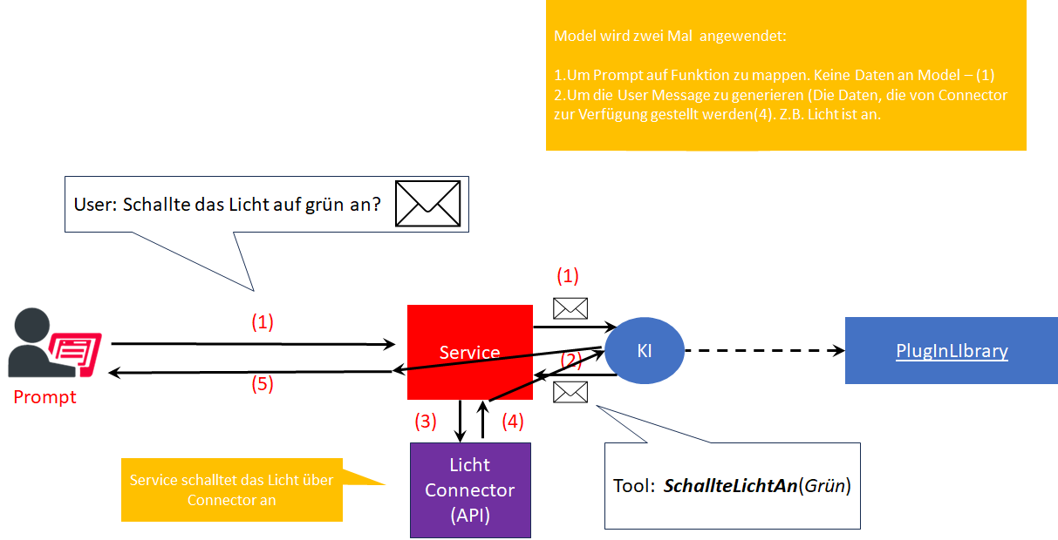
Function Calling
Schritt 2:
KI ermittelt aus dem Prompt die passende Funktion und Argumente. Bsp.:
SchallteLichAn(grün)
Plugin Library
Enthält die Beschreibungen von Funktionen.

Slide 19
SEMANTIC KERNEL

Slide 20
Semantic Kernel is an open-source SDK that lets you easily combine Generative AI Models syntactic programming languages like C#, Python an JAVA.
Currently supported languages: C#, Python
Currently supported AI Services: OpenAI, Azure OpenAI, and Hugging Face
Introduction | 🦜️🔗 Langchain

Slide 21
Why to use SK?
SK is a framework to build agents
You can easily use LLM models for chat, create images and video so on.
Making automated Agents that automate business processes is hard?
You need a framework for such complex engineering tasks.

Slide 22
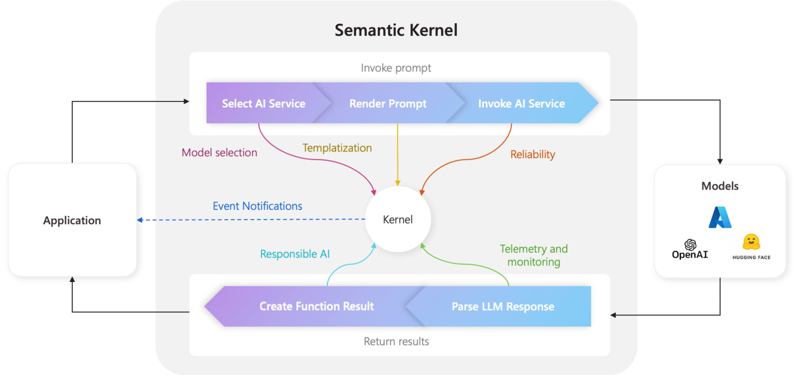
Architecture of the “Smart” application

Slide 23
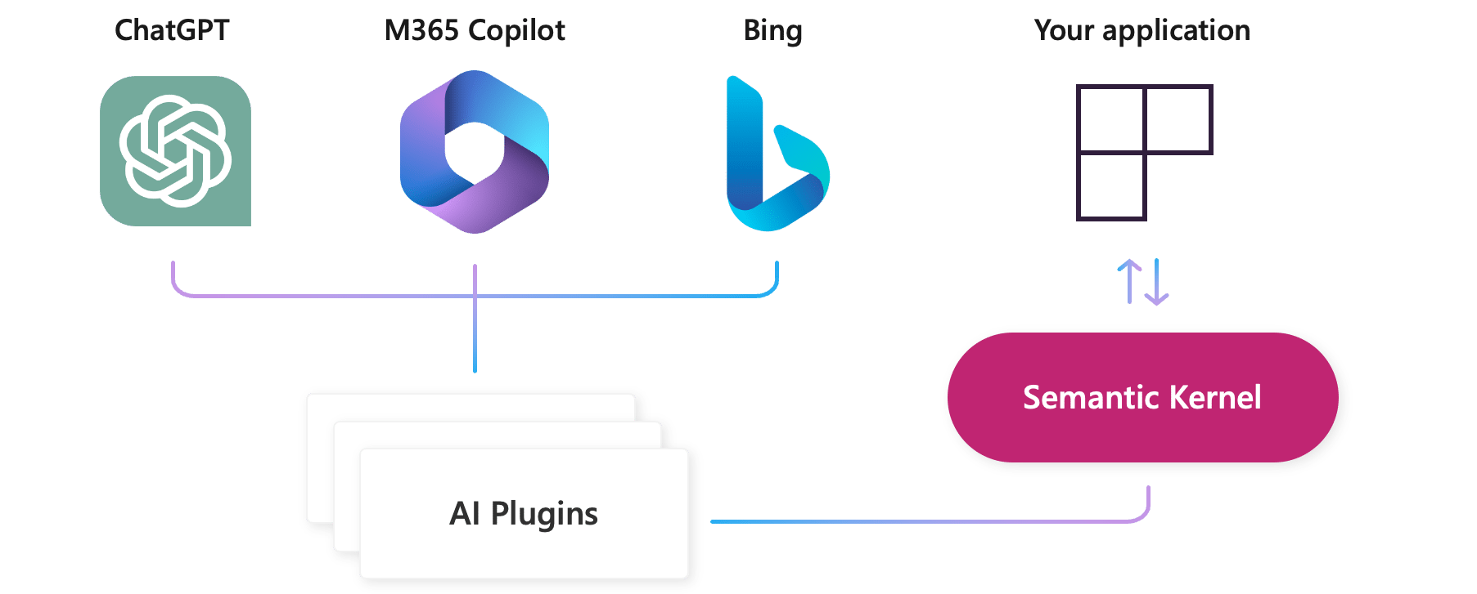
AI Plugins
Your SK application
a plugin is a group of functions
that can be exposed to AI applications
OpenAI plugin specification

Slide 24
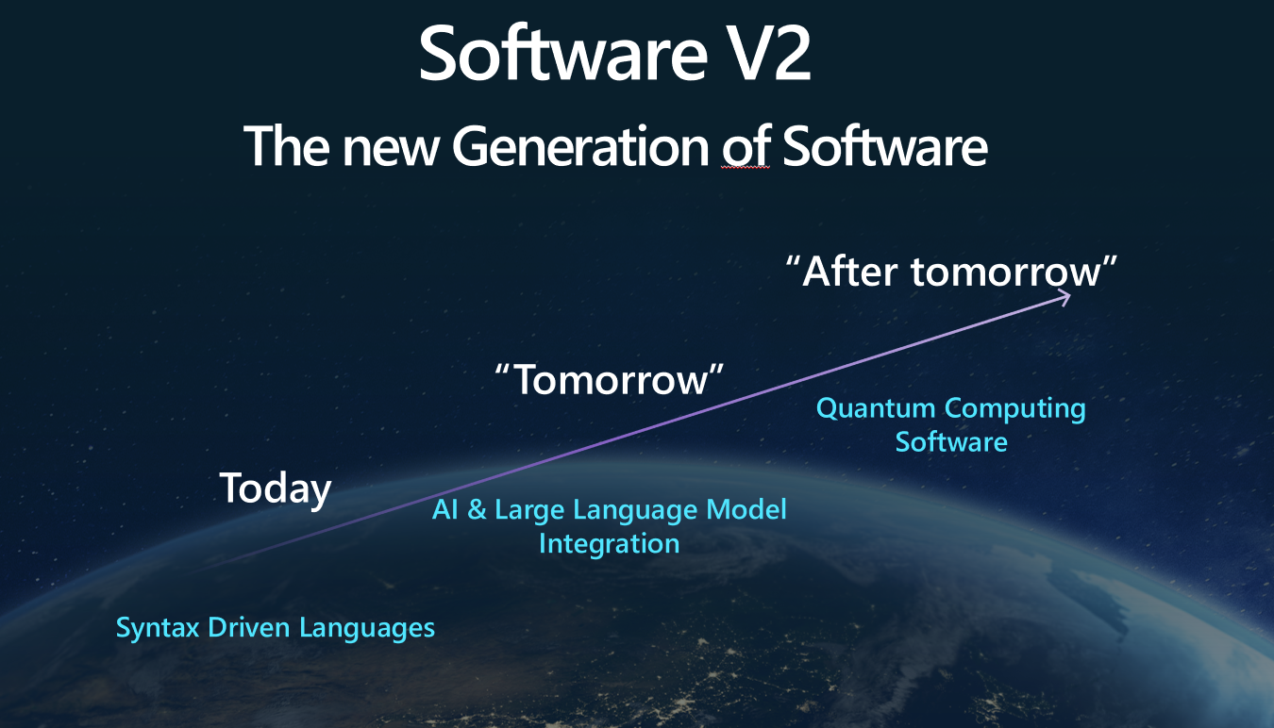
The Knowledge is inside Plugins
Native Functions (C#, Python, JAVA, ??)
Prompts (Semantic Functions)

Slide 25
NATIVE FUNCTIONS
[SKFunction, Description("Gets the UTC current time.")]
public string UtcNow()
{
return DateTime.UtcNow.ToString();
}
A native function is a function
defined by the code

Slide 26
PROMPTS (SEMANTIC FUNCTIONS)
Inline Functions
string prompt = @"Bot: How can I help you?
User: {{$input}}
---------------------------------------------
The intent of the user in 5 words or less: ";
A semantic function is a function
defined by the LLM prompt
Plugins
│
│─── Plugin1
│
│─── Function11
│─── Function12
└─── Plugin2
│
│─── Function21
│─── Function22
Add Ins
In-file Functions

Slide 27
DEMO
Controlling the lighting system

Slide 28
Deep Dive into Semantic Kernel
Overview of the kernel
Creating native functions
Creating semantic functions
Understanding AI plugins
Planer
Create and run a ChatGPT plugin

Slide 29
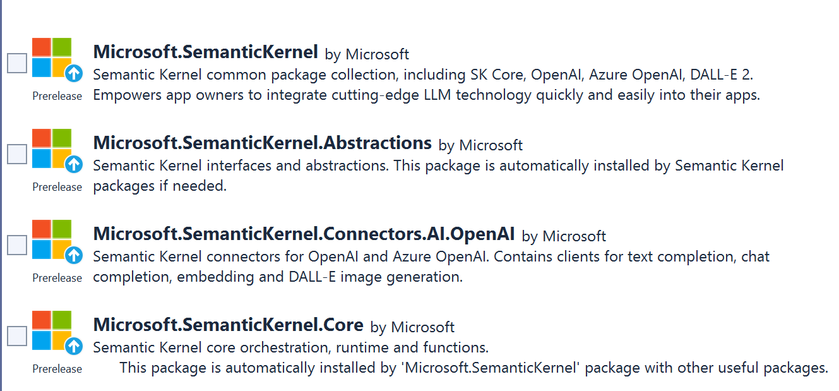
SEMANTIC KERNEL OVERVIEW

Slide 30
Semantic Kernel Initialization with OpenAI
private static IKernel GetAzureKernel()
{
var kernel = kernel = Kernel.CreateBuilder()
.AddOpenAIChatCompletion(
Environment.GetEnvironmentVariable("OPENAI_CHATCOMPLETION_DEPLOYMENT")!,
Environment.GetEnvironmentVariable("OPENAI_API_KEY")!,
Environment.GetEnvironmentVariable("OPENAI_ORGID")!)
.Build();}

Slide 31
Semantic Kernel Initialization with Azure OpenAI
private static IKernel GetKernel()
{
var kernel = kernel = Kernel.CreateBuilder()
.AddAzureOpenAIChatCompletion(
Environment.GetEnvironmentVariable("AZURE_OPENAI_CHATCOMPLETION_DEPLOYMENT")!,
Environment.GetEnvironmentVariable("AZURE_OPENAI_ENDPOINT")!, Environment.GetEnvironmentVariable("AZURE_OPENAI_API_KEY")! )
.Build(); }

Slide 32
Two types of functions
Native Functions
Semantic Functions

Slide 33
DEMO
Native Functions

Slide 34
Nested Native Functions Semantic function invokes a native function
{{SamplePlugin.Translator $input}}
--------------------------------------
Summarize the scientific abstract using a user friendly language. Counter = {{StringPlugin.CharCount $input}}
Provide the result in following format:
[Output]
Counter: number,
Text: translated text
[Input]
{{$input}}
--------------------------------------
[Output]
Notes:
Lines ----- are important. Without them translation will be done, but not used as a final result. Final result will be summarized abstract without translation.
Interestingly both lines are required.
2. CharCount will be executed with summarized English text instead of translated text. The function is invoked bevore the translator function is invoked.

Slide 35
Nested Semantic Functions Semantic function invokes a semantic function
{{SamplePlugin.Translator $input}}
-----------------------------------------------
Summarize and compress abstract to 50 words, using a user friendly language.
[Input]
{{$input}}

Slide 36
DEMO
Semantic Functions

Slide 37
Planers
Planner is a function
I takes a prompt and returns back a plan on how to accomplish the task described in the prompt.
Mix-and-match the plugins.
Recombine them into a series of steps that complete a goal.
Converts the prompt into
orchestration of functions
implemented in Plugins
If my investment of 2130.23 dollars increased by 23%, how much would I have after I spent $5 on a latte?
Planers

Slide 38

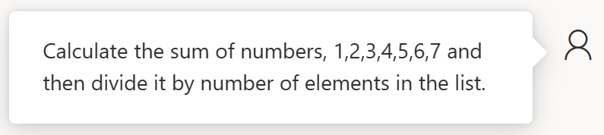

Slide 39
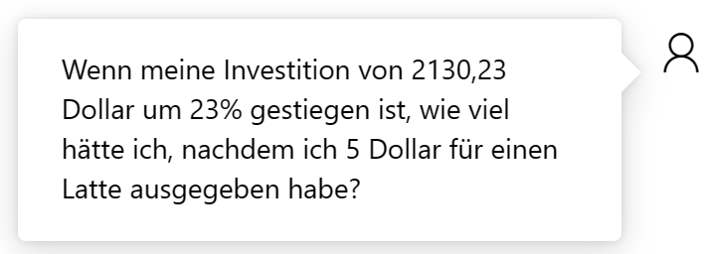
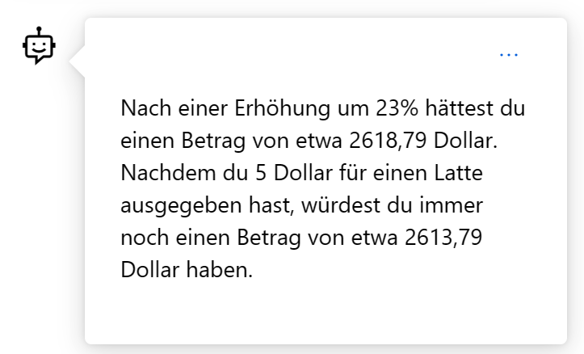

Slide 40

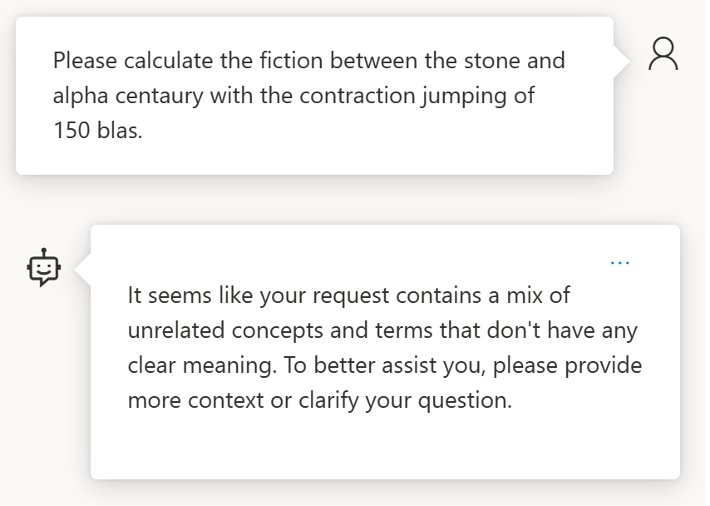
How about something not solvable?

Slide 41


References
Azure/aistudio-copilot-sample at oct-refresh (github.com)
Microsoft Copilot Studio
https://platform.openai.com/docs/models https://oai.azure.com/portal/****/models
Azure AI Foundry
Semantic Kernel
AI-Generated 3D Worlds
Imagine AI Art Generator
Midjourney
Azure AI SDK - Azure AI Studio
BOOK OF NEWS - Microsoft Ignite
LiveBench
Function calling - OpenAI API

Slide 42
Enable Copilot Coding Agent
GitHub Copilot: Meet the new coding agent - The GitHub Blog
Enabling Copilot coding agent - GitHub Enterprise Cloud Docs (License Pro+ required)

Slide 43
References
Open AI
https://platform.openai.com/docs/models
Azure Open AI https://oai.azure.com/portal/****/models
Request Access to Azure OpenAI Service (microsoft.com)

Slide 44

Model Context Protocol
csharp-sdk/samples/AspNetCoreSseServer at main · modelcontextprotocol/csharp-sdk

Slide 45
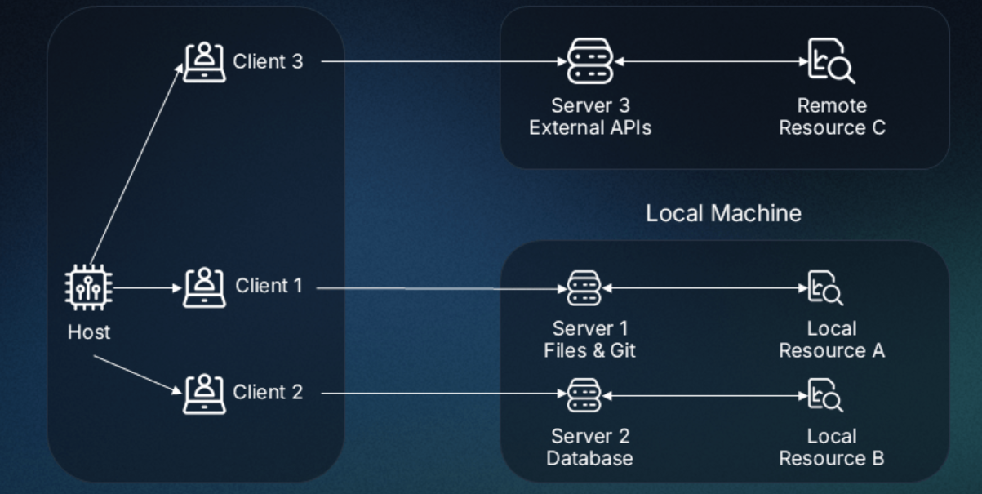
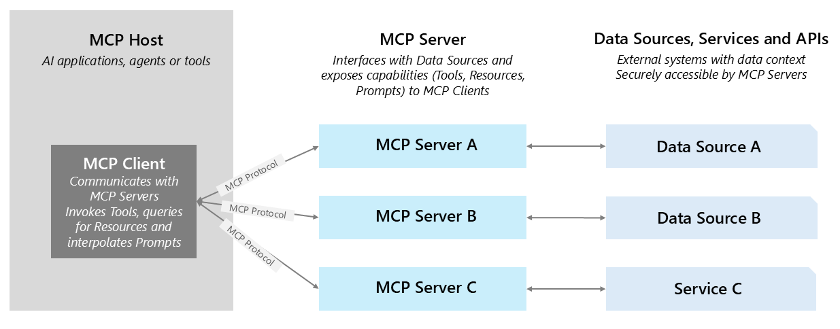
The idea of MCP

Slide 46
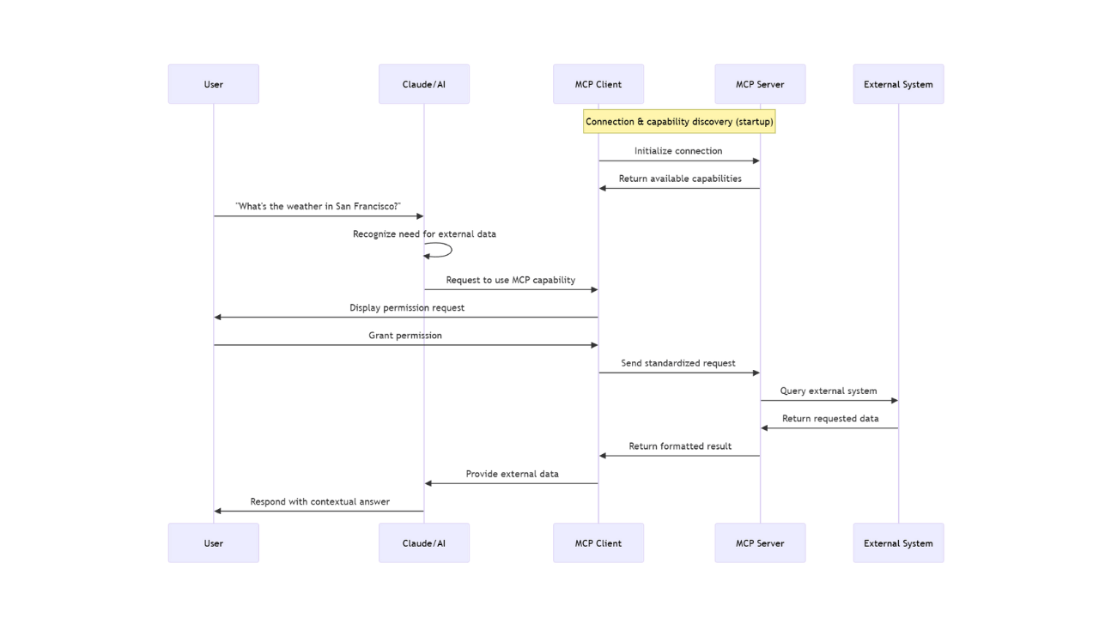
MCP

Slide 47
MCP Transports
StdIo
SSE
One-way communication: From server to client (unlike WebSockets, which are bidirectional).
Persistent connection: The client opens a connection, and the server
keeps it open to send updates.
Text/event-stream MIME type: Data is sent in a specific format over a stream.

Slide 48
DEMO
MCP Server StdioTransport
MCP Server SseTransport
MCP Client

Slide 49
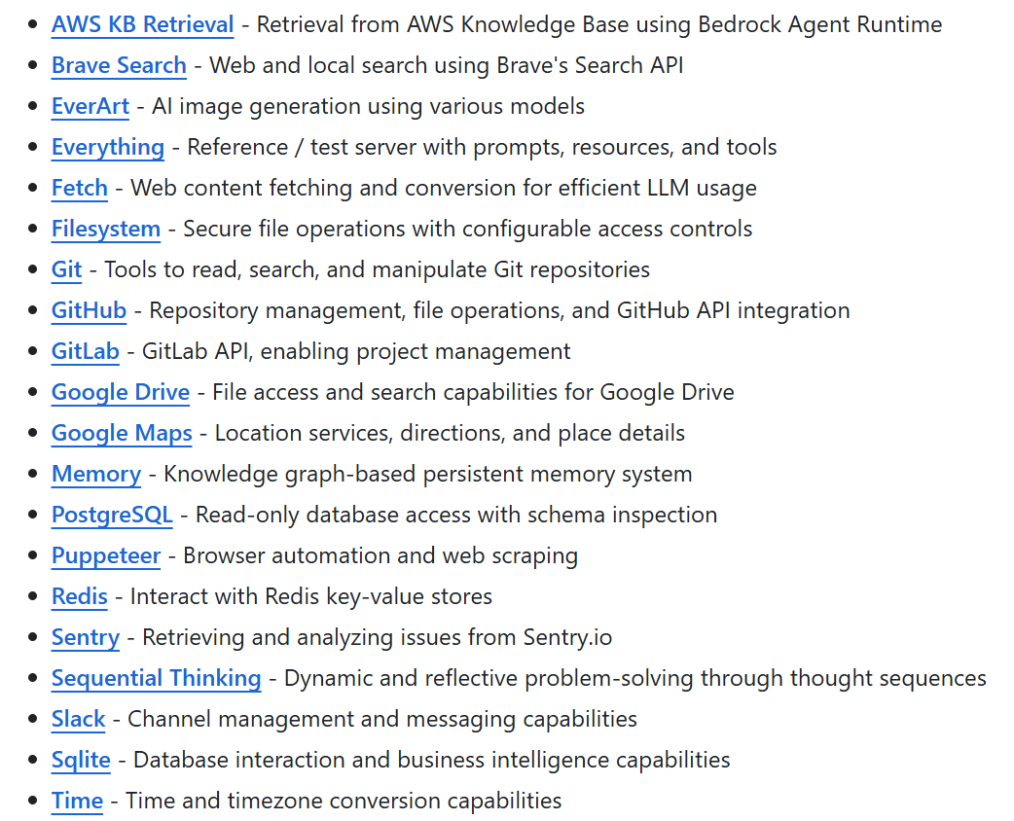
Reference Servers
modelcontextprotocol/servers: Model Context Protocol Servers

Slide 50
Awesome MCP Servers
https://mcpservers.org/

Slide 51
Microsoft confidential
https://github.com/ddobric/semantic-kernel-training/

